Slide 1
ELEMENTARY DATA LINK PROTOCOLS

Slide 2
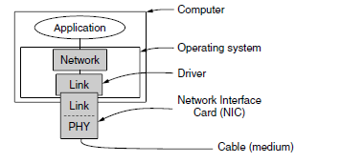
Implementation of the physical, data link, and network layers

Slide 3
Cntn.
The physical layer process and some of the data link layer process run on dedicate hardware called a NIC
(Network Interface Card).
The rest of the link layer process and the network layer process run on the main CPU as part of the operating system, with the software for the link layer process often taking the form of a device driver.
However,other implementations are also possible (e.g., three processes offloaded to dedicated hardware called a network accelerator, or three processes running on the main CPU on a software-defined ratio).

Slide 4
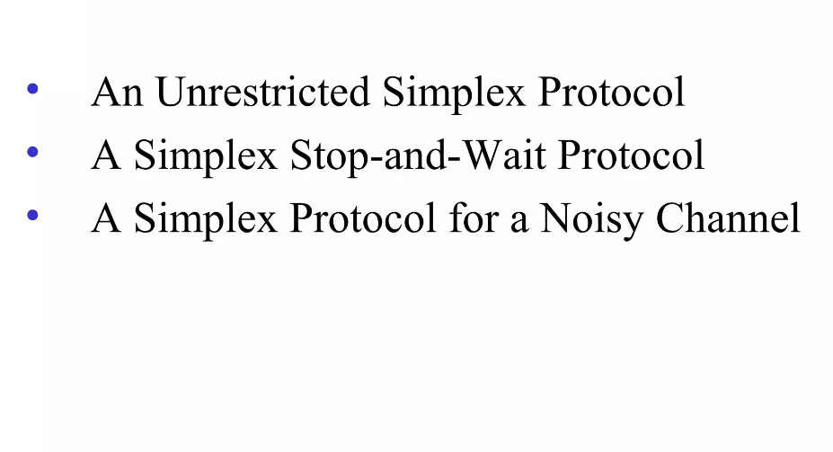
Elementary Data Link Protocol

Slide 5
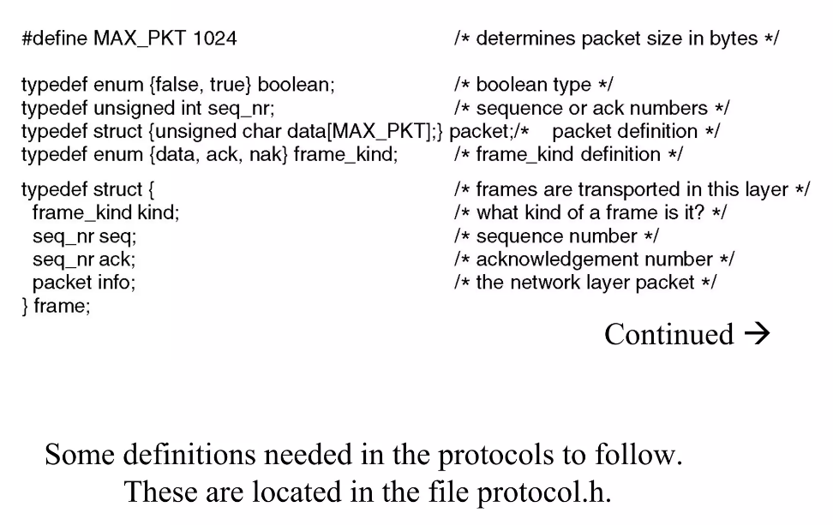
Protocol definition

Slide 6
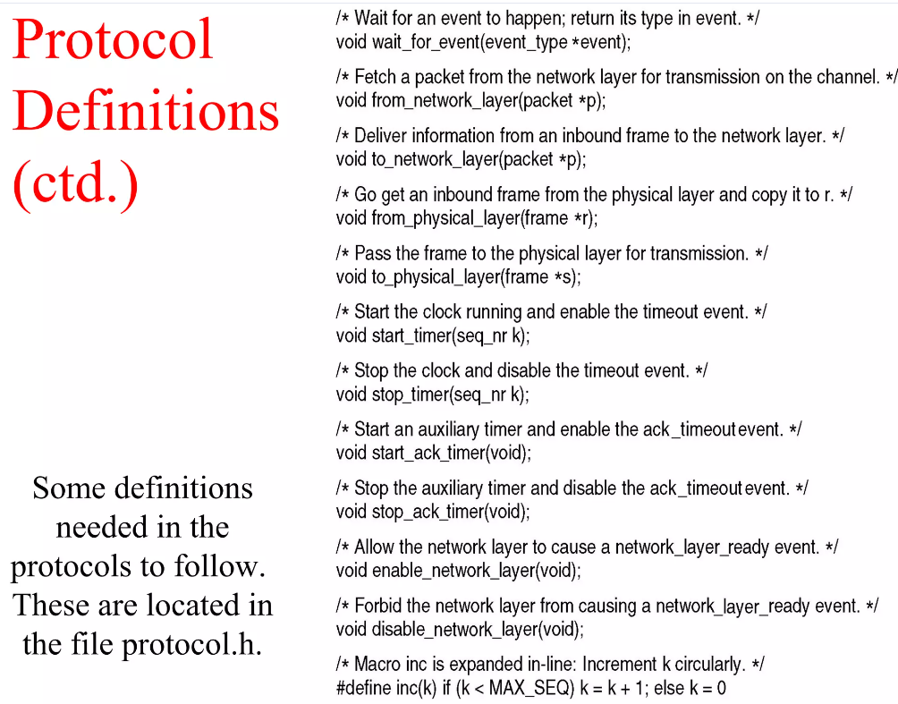
Cont,

Slide 7
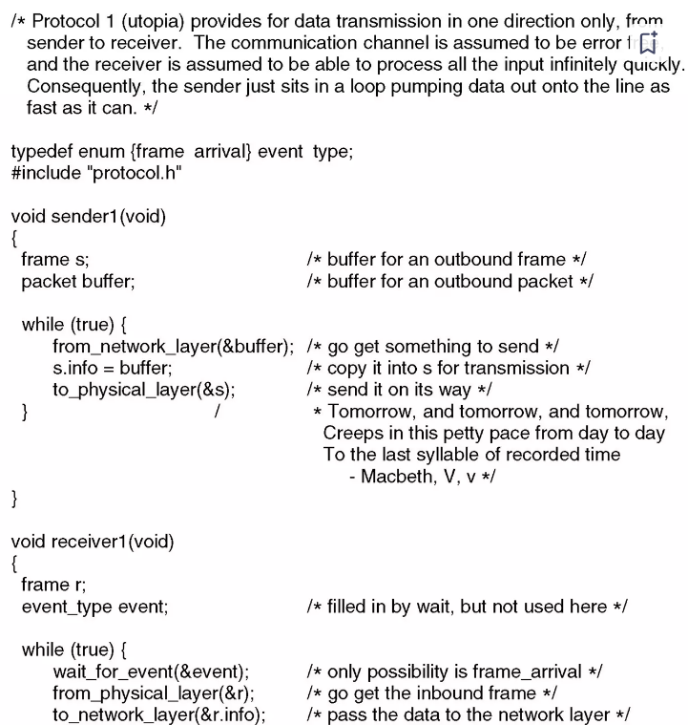
Unrestricted Simplex Protocol

Slide 8
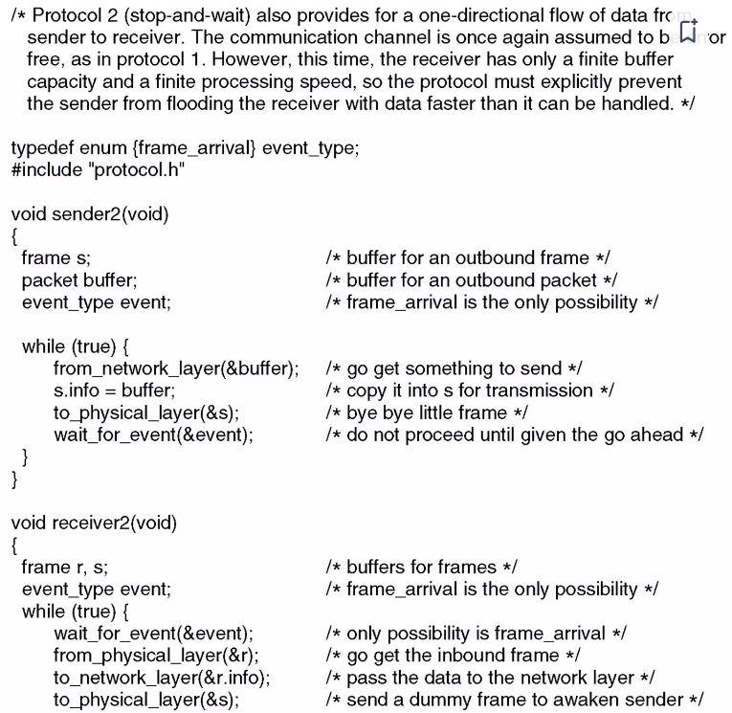
Simplex Stop and Wait Protocol

Slide 9
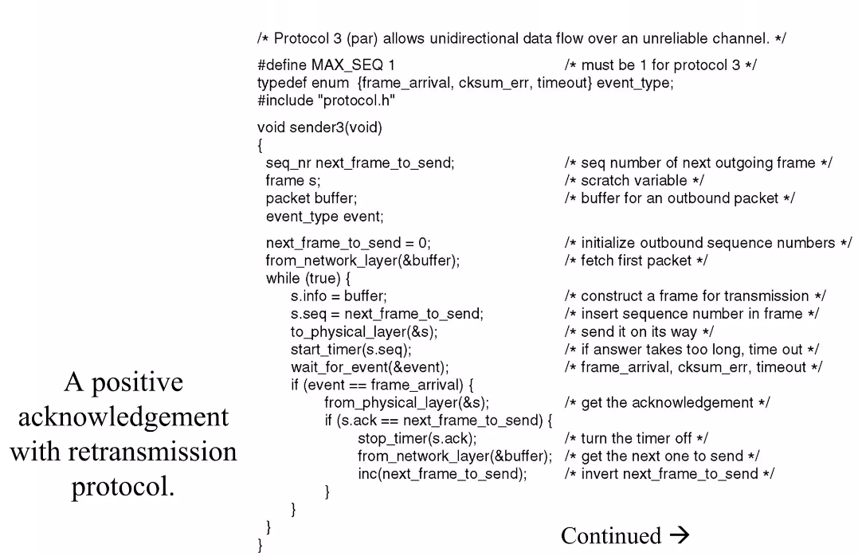
A Simplex protocol for Noisy channel

Slide 10
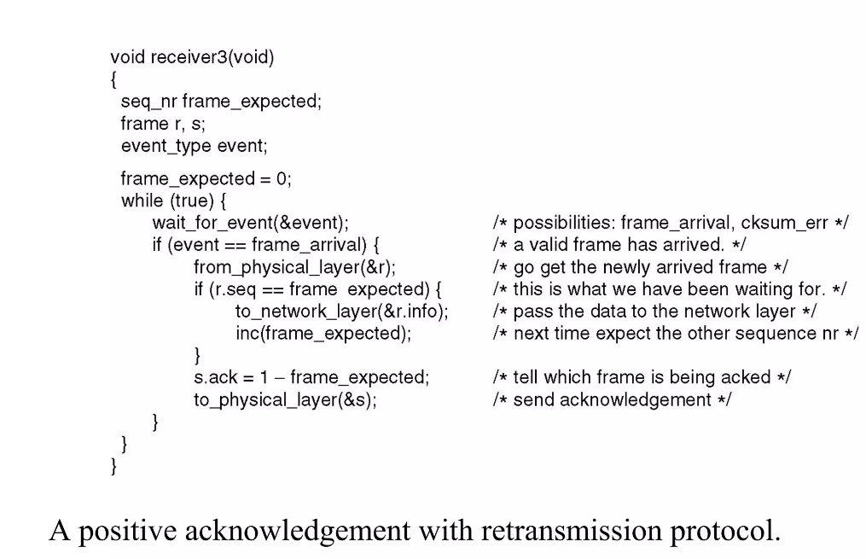
Cntn,

Slide 11
SLIDING WINDOW PROTOCOLS
Sliding window protocols are data link layer protocols for reliable and sequential delivery of data frames. The sliding window is also used in Transmission Control Protocol.
In this protocol, multiple frames can be sent by a sender at a time before receiving an acknowledgment from the receiver.
The term sliding window refers to the imaginary boxes to hold frames. Sliding window method is also known as windowing.
When a data frame arrives, instead of immediately sending a separate control frame, the receiver restrains itself and waits until the network layer passes it the next packet.
The acknowledgement is attached to the outgoing data frame (using the ack field in the frame header).
In effect, the acknowledgement gets a free ride on the next outgoing data frame.
The technique of temporarily delaying outgoing acknowledgements so that they can be hooked onto the next outgoing data frame is known as piggybacking.

Slide 12
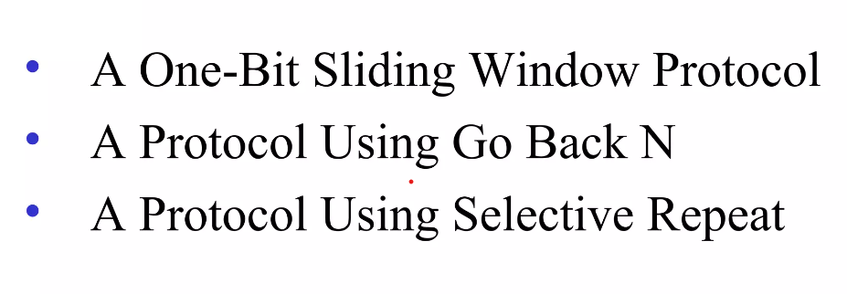
Protocols

Slide 13
A One-Bit Sliding Window Protocol
In one – bit sliding window protocol, the size of the window is 1.
So the sender transmits a frame, waits for its acknowledgment, then transmits the next frame.
Thus it uses the concept of stop and waits for the protocol. This protocol provides for full – duplex communications.
Hence, the acknowledgment is attached along with the next data frame to be sent by piggybacking

Slide 14
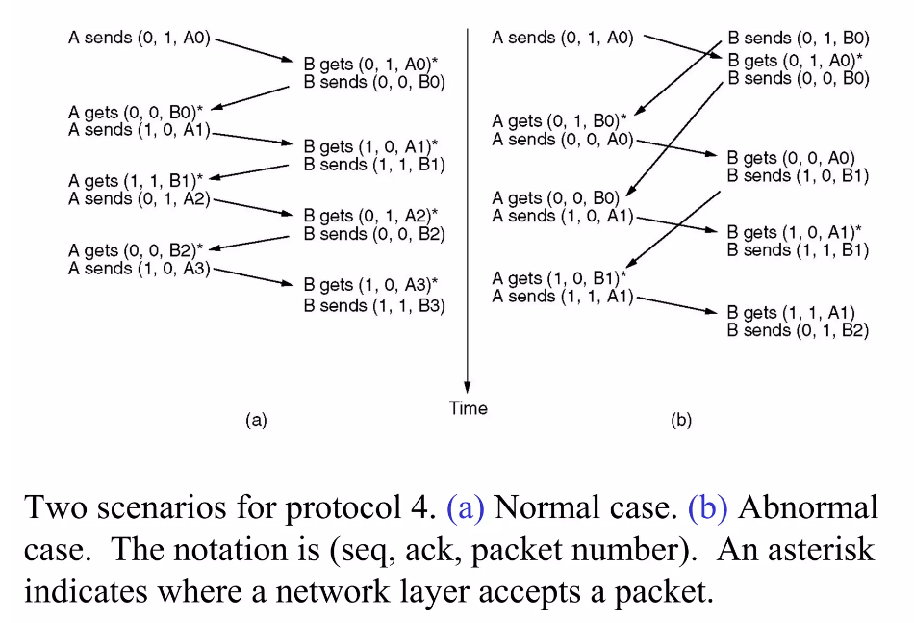
Cntn,

Slide 15
Sliding window protocol using Go-back N
Go-Back-N protocol, also called Go-Back-N Automatic Repeat reQuest, is a data link layer protocol that uses a sliding window method for reliable and sequential delivery of data frames.
It is a case of sliding window protocol having to send window size of N and receiving window size of 1.

Slide 16
Cntn,
For example, if the sending window size is 4, then the sequence numbers will be 0, 1, 2, 3, 0, 1, 2, 3, 0, 1, and so on.
The number of bits in the sequence number is 2 to generate the binary sequence 00, 01, 10, 11.
The size of the receiving window is 1.

Slide 17
A Protocol using Selective Repeat
Selective repeat protocol, is to allow the receiver to accept and buffer the frames following a damaged or lost one.
In this protocol, both sender and receiver maintain a window of outstanding and acceptable sequence numbers, respectively.
The sender’s window size starts out at 0 and grows to some predefined maximum.
The receiver’s window, in contrast, is always fixed in size and equal to the predetermined maximum.

Slide 18
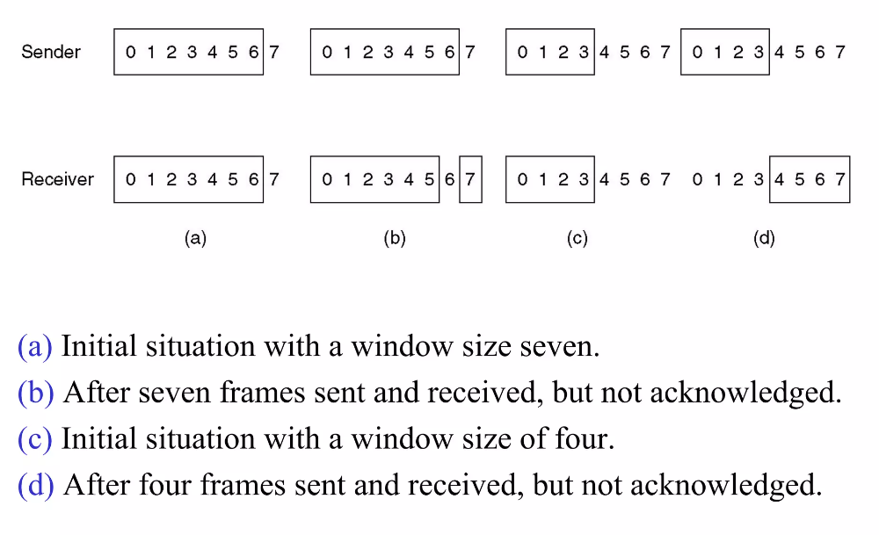
Cntn,

Slide 19
Protocol Verification
Finite State Machined Model
Petri Net Model

Slide 20
Finite State Machined Model
Finite state machines mainly consist of a set of transition rules.
In the traditional finite state machines model, the environment of the machine consists of two finite and disjoint sets of signals, input signals and output signals.
Also, each signal has an arbitrary range of finite possible values

Slide 21
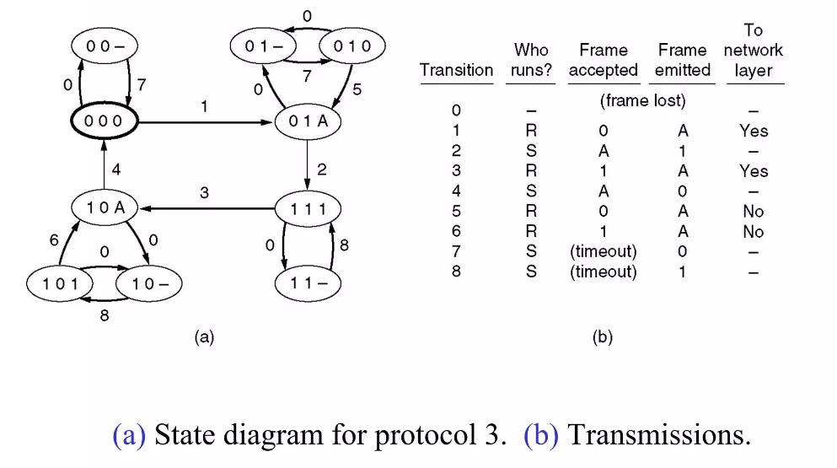
Finite State Machined Model

Slide 22
Petri Net Model
A Petri Net is a graphical and mathematical tool to verify systems and protocols.
Petri Nets used to analyze and verify systems in different areas of science such as artificial intelligence, parallel processing system, control systems, and numerical analysis.
Petri Nets in the graphical forms are like flowcharts and network diagrams, while in mathematical forms, they are like algebra and logic subjects.
Recently used to verify cryptographic and security protocols

Slide 23
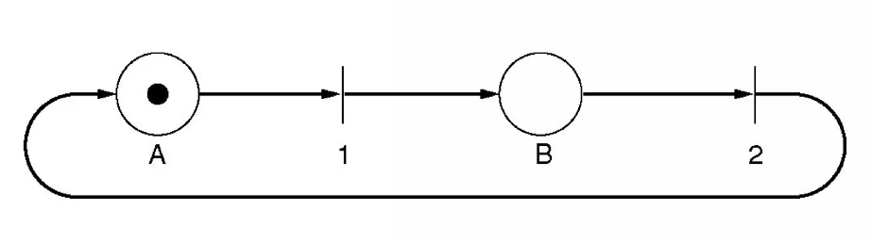
A Petri net with two places and two transitions

Slide 24
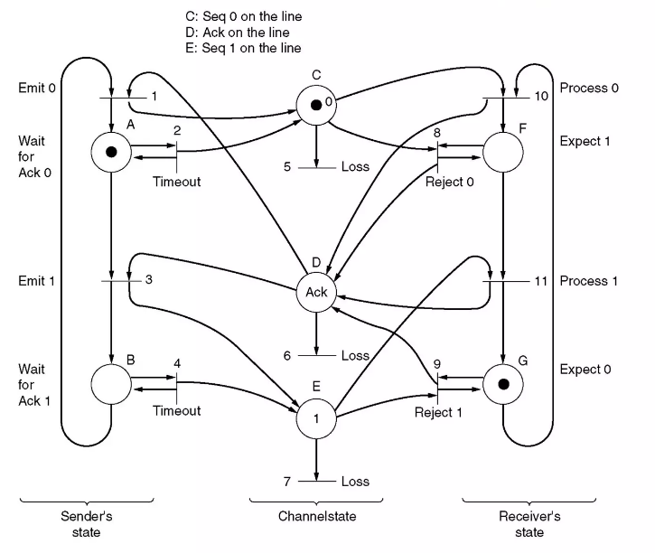
Petri Net Model

Slide 25
Channel Allocation Multiple Access protocols
Channel allocation is a process in which a single channel is divided and allotted to multiple users in order to carry user specific tasks.
There are user’s quantity may vary every time the process takes place.
If there are N number of users and channel is divided into N equal-sized sub channels, Each user is assigned one portion.
If the number of users are small and don’t vary at times, then Frequency Division Multiplexing can be used as it is a simple and efficient channel bandwidth allocating technique.

Slide 26
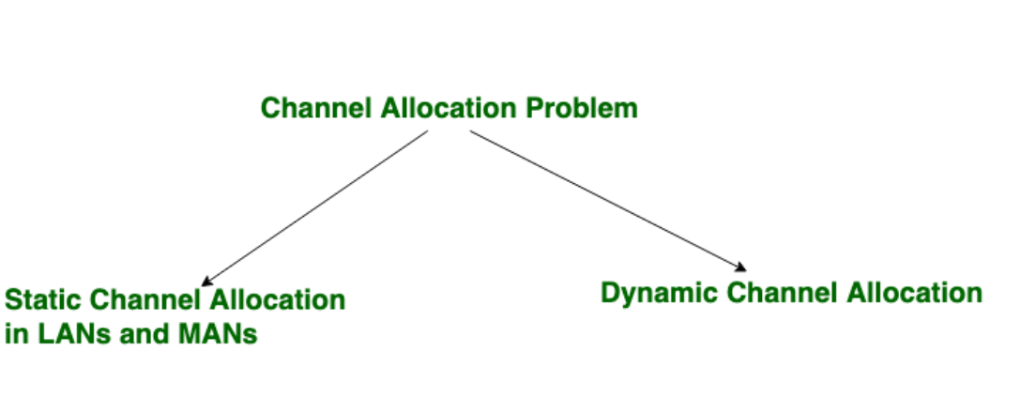
Channel allocation problem can be solved by two schemes:

Slide 27
Static Channel Allocation in LANs and MANs:
It is the classical or traditional approach of allocating a single channel among multiple competing users using Frequency Division Multiplexing (FDM).
In this, a number of signals are transmitted at the same time, and each source transfers its signals in the allotted frequency range. There is a suitable frequency gap between the 2 adjacent signals to avoid over-lapping.
Since the signals are transmitted in the allotted frequencies so this decreases the probability of collision.
If there are N users, the frequency channel is divided into N equal sized portions (bandwidth), each user being assigned one portion.
Since each user has a private frequency band, there is no interference between users.

Slide 28
Dynamic Channel Allocation
In dynamic channel allocation scheme, frequency bands are not permanently assigned to the users. Instead channels are allotted to users dynamically as needed, from a central pool.
The allocation is done considering a number of parameters so that transmission interference is minimized.

Slide 29
Multiple Access Protocols in Computer Network
If there is a dedicated link between the sender and the receiver then data link control layer is sufficient, however if there is no dedicated link present then multiple stations can access the channel simultaneously.
Hence multiple access protocols are required to decrease collision and avoid crosstalk.
For example, in a classroom full of students, when a teacher asks a question and all the students (or stations) start answering simultaneously (send data at same time) then a lot of chaos is created( data overlap or data lost) then it is the job of the teacher (multiple access protocols) to manage the students and make them answer one at a time.

Slide 30
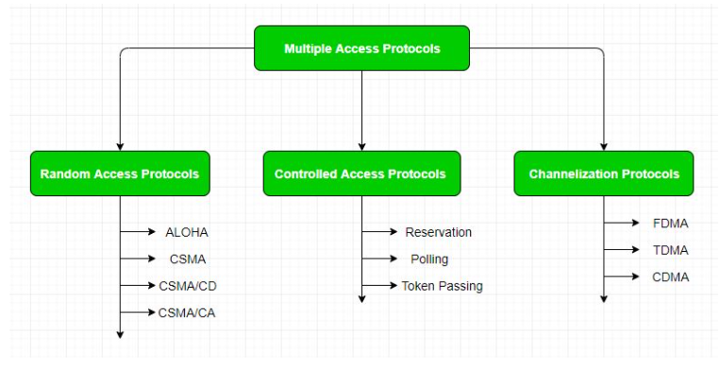
Multiple access protocols

Slide 31
Cntn,
1. Random Access Protocol: In this, all stations have same superiority that is no station has more priority than another station. Any station can send data depending on medium’s state( idle or busy).
2. Controlled Access: In this, the data is sent by that station which is approved by all other stations.
3. Channelization: In this, the available bandwidth of the link is shared in time, frequency and code to multiple stations to access channel simultaneously.

Slide 32
IEEE
Institute of Electrical and Electronics Engineers, is an organization that develops standards for the electronics industry and computers.
IEEE is composed of numerous scientists, engineers, and students from all over the globe.
The main AIM of IEEE is to ensure foster technological innovation and excellence for the benefit of humanity.
The IEEE standards in computer networks ensure communication between various devices; it also helps to make sure that the network service, i.e., the Internet and its related technologies, must follow a set of guidelines and practices so that all the networking devices can communicate and work smoothly.

Slide 33
Contn,
IEEE divided the data link layer into two sub-parts, namely
LLC or Logical Link Control and
MAC or Media Access Control.

Slide 34
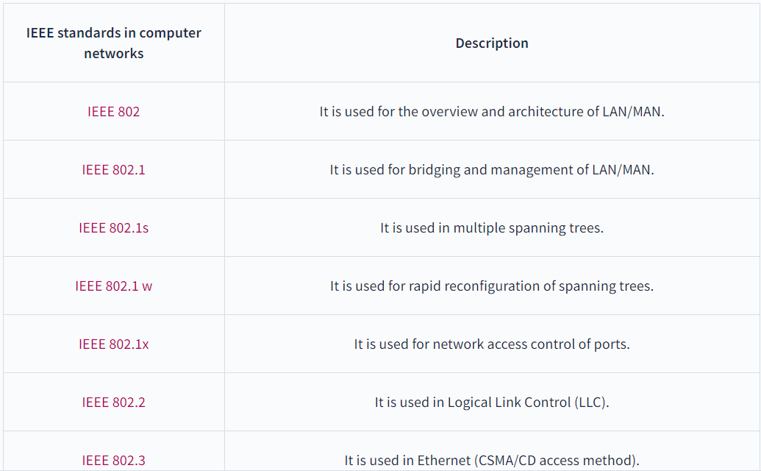
IEEE 802 Standards

Slide 35
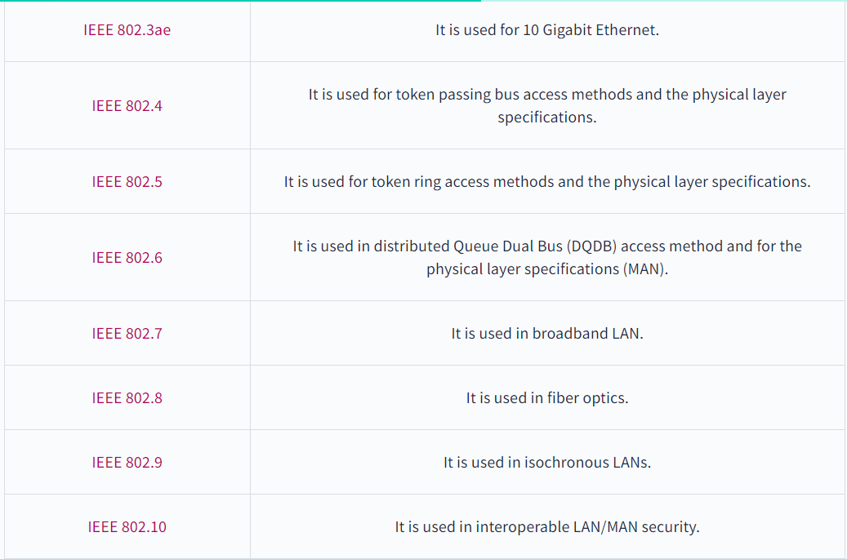
Cntn,

Slide 36
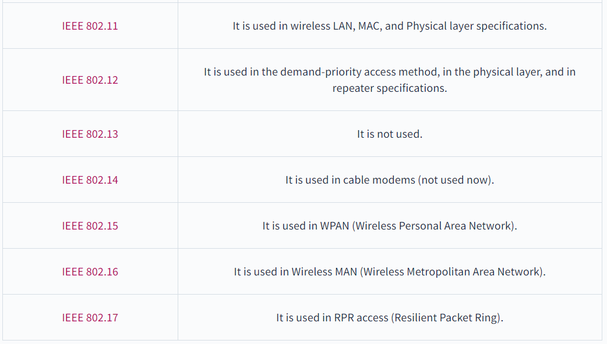
Cntn,

Slide 37
Assignment 1
Network Topology
Network Architecture
Transmission media
Error Detection and Correction Methods
Sliding Window Protocols Protocol
Channel Allocation Multiple Access protocols

